Slide 1

Convolutional Neural Networks (CNNs)
Presenter : Ms. Raunak Masih
Student Number : 202405832
Course : Applied Artificial Intelligence

Slide 2

What is Convolutional Neural Networks(CNNs) Alzubaidi et al. (2021)
CNNs are specialized deep learning algorithms created to process and analyze image data, such as photos and videos.
These networks imitate the structure and functions of the visual cortex in the human brain.

Slide 3

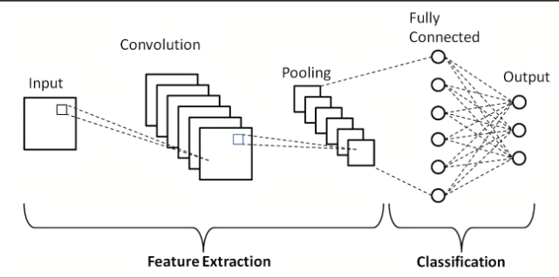
Architecture of CNN
Image Reference: Phung and Rhee (2019 )

Slide 4
Key Components of Convolutional Neural Networks (CNNs) : Alzubaidi et al. (2021)
Convolutional Layers:
Apply a set of learnable filters to the input image.
Filters slide over the image, computing the dot product to produce feature maps that highlight detected features.
Activation Layers:
Apply an activation function like ReLU (Rectified Linear Unit) after convolution.
Allows the network to learn and represent complex patterns beyond linear relationships.
Pooling Layers:
Reduce the dimensionality of feature maps.
Reduces computational load for the network.
Fully Connected Layers:
Each neuron in one layer connects to every neuron in the next layer.
Uses features from convolutional and pooling layers to determine the final output, such as classifying objects in an image.

Slide 5
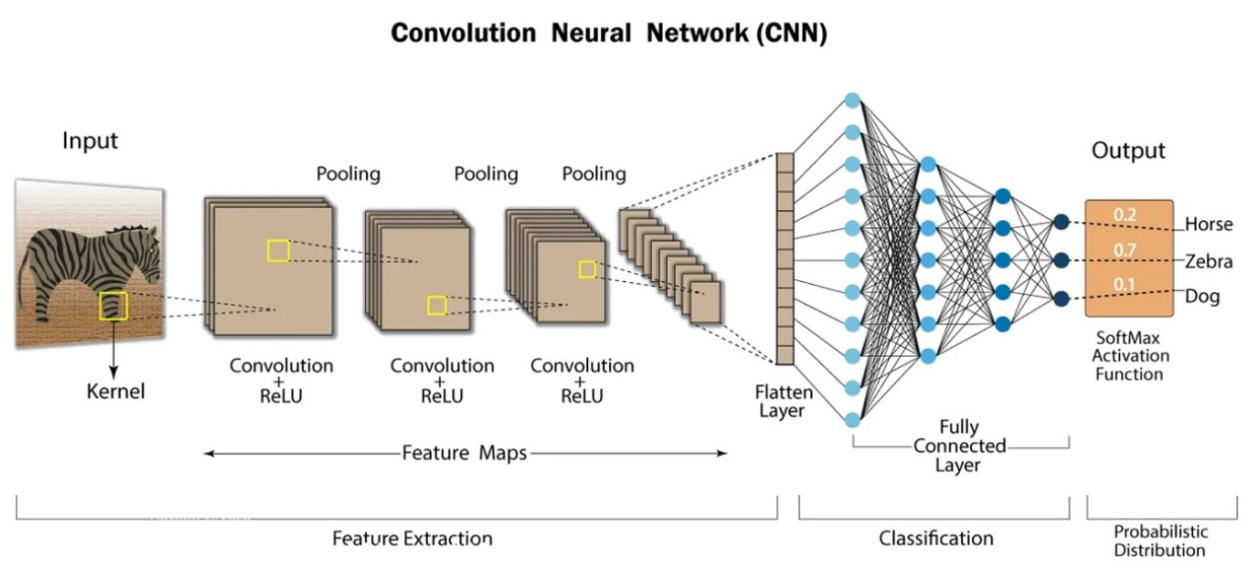
Image Reference: Alharbi and Hewahi (2021)

Slide 6
Explanation of Example Zebra:
Input: The original image data, which is often a pixel-value matrix.
Convolution + ReLU: Highlights patterns in the image. Non-linearity is introduced by the (ReLU).
Pooling: Uses max pooling to reduce feature map.
Flattening: Prepares data for the fully connected layers.
Fully Connected Layer: Neurons from earlier layers join for the purpose of recognizing patterns.
Softmax Activation Function: Converting logits into probabilities that represent the chances of each class (e.g., Horse, Zebra, Dog).

Slide 7
Ethical Issue in CNN Applications Angileri et al. (2019)
CNNs can inherit and amplify biases from training data, leading to unfair and discriminatory predictions in applications like facial recognition:
Bias in Demography exhibit higher error for women and people with darker skin tones.
Consent and Data Collection raises privacy concerns.
Transparency is lacking in such a complicated system makes it difficult to recognize and eliminate biases.
Classification of Gender – Non-binary individuals are overlooked.

Slide 8
Title: Real-Time Arrhythmia Detection Using CNNs: Link: https://go.exlibris.link/j0fnFQHJ
Goals of a Research Paper
Design a Detection System for early diagnosis of the diseases.
Make use of CNNs to process and analyze visual inputs.
Attain Maximum Accuracy by using ANSI–AAMI standards.
Applications in Real Time and implements on both CPU and GPU.
Handheld medical devices.

Slide 9
Following are the Motivation of the Research paper mentioned:
Higher Mortality Rate by facilitating early and accurate detection.
CNN Effectiveness in feature extraction and classification.
For feature extraction and noise reduction use multistage approach.
Real-World Application in Practice.

Slide 10
Why a CNN is Suitable for the Task in the Paper?
Feature Extraction Capability
Managing 1D Data
Architecture in Layers
Diminishment of Overfitting
Optimizer Productivity
Real-time Application

Slide 11
How CNN was used in the paper?
1. CNN Architecture:
Input Layer
8 Convolutional Layers (Conv1D)
4 Max-pooling Layers
3 Dropout Layers
2 Dense layer
Softmax Layers

Slide 12


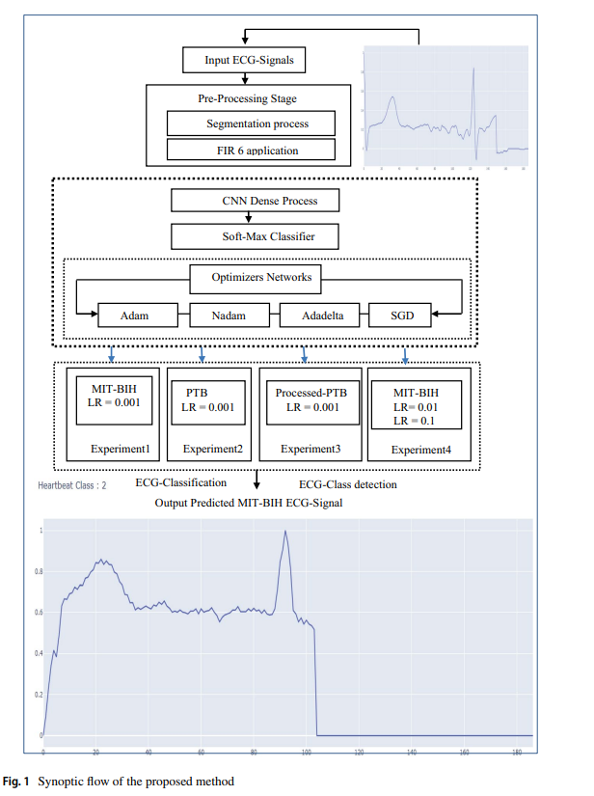

Image Reference : https://go.exlibris.link/j0fnFQHJ

Slide 13
How CNN was used in the paper?
2. Preprocessing:
Low-pass filtering for noise removal
Segmenting R-R peaks produces segments of 1.496 seconds..
Signal normalization is done to set the amplitude interval between 0 and 1.

Slide 14
How CNN was used in the paper?
3. Real-time Performance:
Fully Convolutional Network(FCN) is employed.
4 optimizer network used : Adam, Adadelta, SGD, and Nadam.
GPU and CPU are utilized.

Slide 15
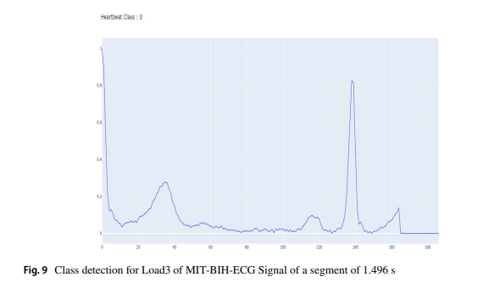
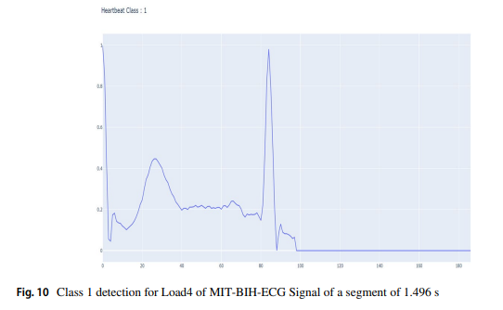
Visualizations:
The MIT-BIH database were classified into 5 classes and the predicted class detection results shows high performance.
The figure shows only for 2 classes i.e., Fig 9 and Fig 10.
Image Reference : https://go.exlibris.link/j0fnFQHJ

Slide 16
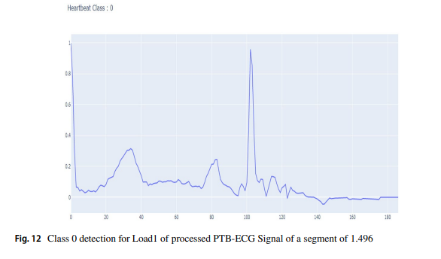
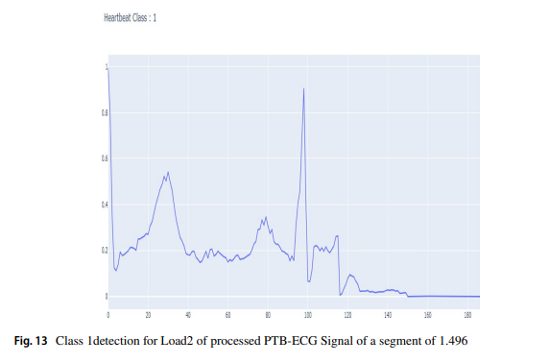
Proposed PTB Database: Two clasees were well detected as shown in figure: normal and abnormal ECG Signals.
The PTB-ECG results were classified into 2 classes (0 – normal, 1-abnormal ECG Signal).
Image Reference : https://go.exlibris.link/j0fnFQHJ

Slide 17
Performance Metrics:
MIT-BIH dataset: 99.5% accuracy, 0.99 F1-score
PTB dataset: 99.17% accuracy, 0.99 F1-score
Processed PTB dataset: 99.61% accuracy, 0.99 F1-score.

Slide 18





Reflection

Slide 19
What prior knowledge I have about CNN?
Basic understanding of Neural Networks.
CNN used for image related task but limited knowledge of operations.
General knowledge of Machine Learning and mathematical concepts.

Slide 20
What Knowledge I gained after Learning CNN?
Knowledge of each and every layer operations.
Understanding of strides, padding and receptive fields/
How convolutional layer apply filter to input images to produce feature maps.
Overfitting problem and to solve them with methods batch normalization, data augmentation and dropout.

Slide 21
When may CNNs be used more effectively?
Picture classification.
Object detection.
Picture recognition and related visual data processing applications.

Slide 22
Where it is appropriate to consider alternative model rather than a CNN?
Non-visual data or sequential processing tasks(e.g., NLP), RNN models.
For structured tabular data (e.g., spreadsheets, databases) use decision tress or linear models.
When dealing with sparse data (e.g., recommendation systems, text classification) use matrix factorization or collaborative filtering.
If you have limited labeled data, consider transfer learning models like BERT.

Slide 23
How can I use the knowledge I have gained from CNN in future?
Medical Imaging : models for application such as X-ray, MRI and CT scan diseases.
Self – driving automobiles can recognize objects on the road.
Can contribute to further findings about CNN.

Slide 24
References:
Angileri, J. et al. (2019) Ethical Considerations of Facial Classification: Reducing Racial Bias in AI. Available at: https://doi.org/10.13140/RG.2.2.28601.11368.
Alzubaidi, L. et al. (2021) ‘Review of deep learning: concepts, CNN architectures, challenges, applications, future directions’, Journal of Big Data, 8(1), p. 53. Available at: https://doi.org/10.1186/s40537-021-00444-8.
Hewahi, N. and Alharbi, N. (2021) ‘Exploring Deep Neural Network Capability for Intrusion Detection Using Different Mobile Phones Platforms’, IJCDS Journal [Preprint]. Available at: https://doi.org/10.12785/ijcds/1001123.
Phung and Rhee (2019) ‘A High-Accuracy Model Average Ensemble of Convolutional Neural Networks for Classification of Cloud Image Patches on Small Datasets’, Applied Sciences, 9, p. 4500. Available at: https://doi.org/10.3390/app9214500.
Research paper title Link: https://go.exlibris.link/j0fnFQHJ

Slide 25
Thank you

